Slide 1
Urban Path Planning to Minimize GPS Integrity Risk Using PPO
Sriramya “Ramya” Bhamidipati
Group Meeting 12/10/2018

Slide 2
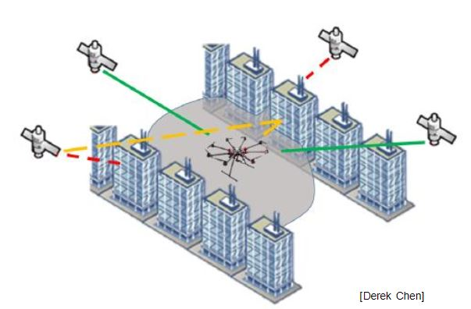
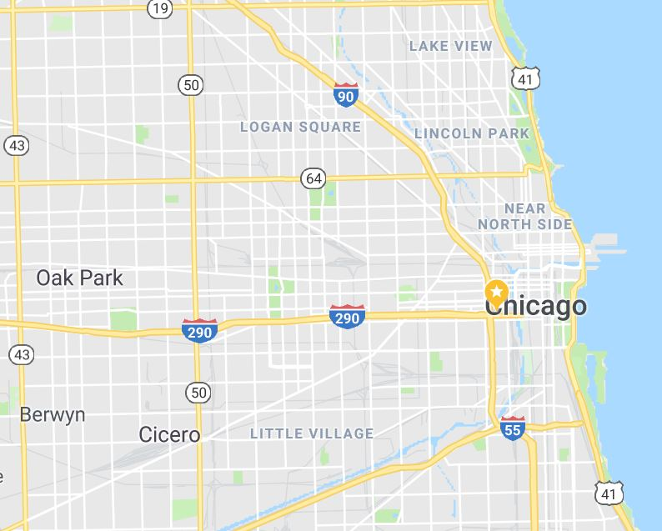
Motivation and Objectives
Multipath due to tall buildings in urban areas
Perform autonomous path planning to minimize the GPS integrity risk, induced due to multipath
Line of Sight
Blocked
End point
Start point
Non-line of Sight
Multiple possible routes
[D. Chen]

Slide 3
Aspects and Assumptions
Assumptions:
GPS satellites are considered static and clock bias errors are ignored
Buildings are considered rectangle blocks and uniform distributions with heights ranging from 20-100m
Given the grid layout of roads in urban areas,
Discrete control actions are considered
Key decision making points are at intersections
Along the rest of the street the same action is continued
Minimize the GPS integrity risk metric

Slide 4
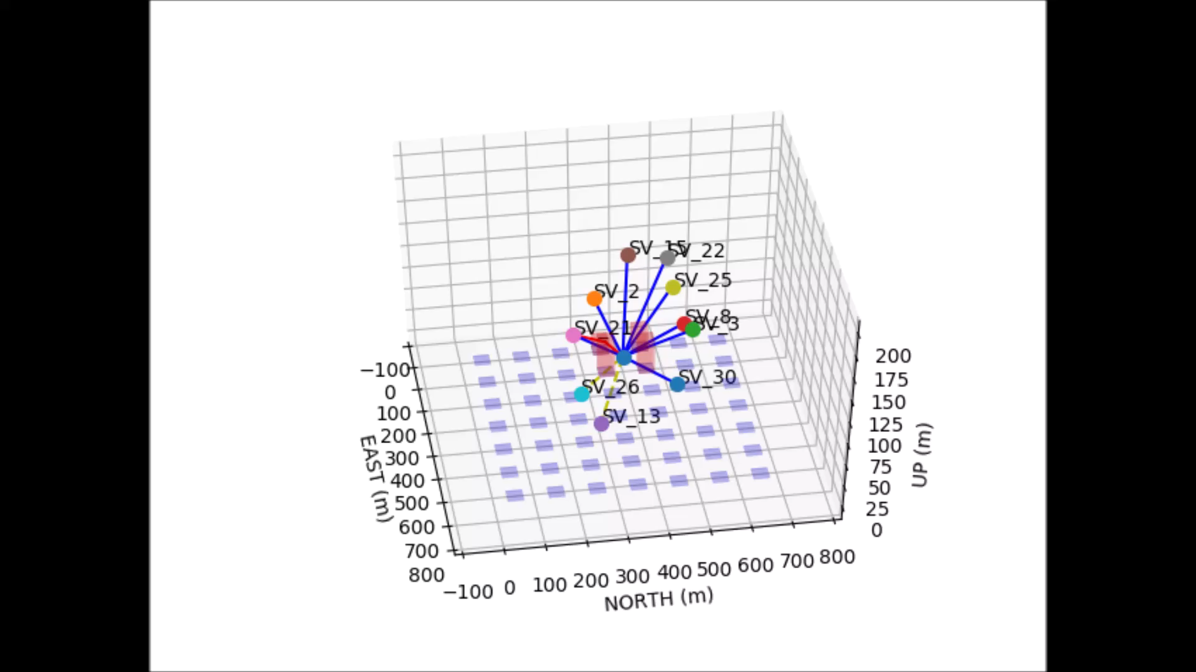
Simulated Environment
Multipath effects are induced due to the surrounding 4 buildings
Building models/LiDAR to obtain the 3D point cloud data
Constant goal is to reach the coordinates (800, 800, 4)
Blue are LOS GPS signals, red are the NLOS signals and dotted yellow are blocked by buildings

Slide 5
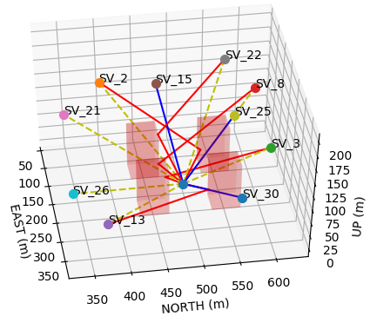
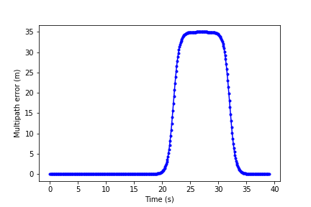
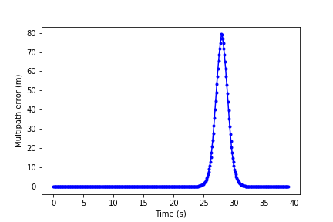
Simulated Environment Cont’d.
Added multipath profiles to NLOS satellites to simulate tracking loop errors
Tanh profile is considered based on random parameters for start time, rate, amplitude
SV 15, 25, 30: Direct Line of sight
SV 2, 3, 8, 13, 22: Non-line of sight
SV 21, 26: Blocked

Slide 6
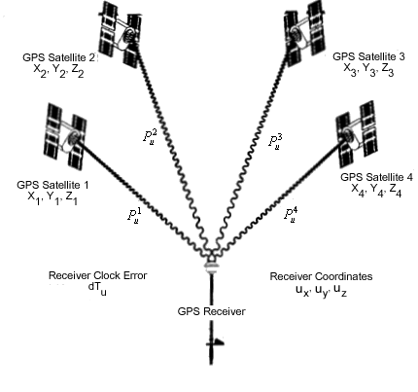
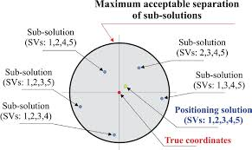
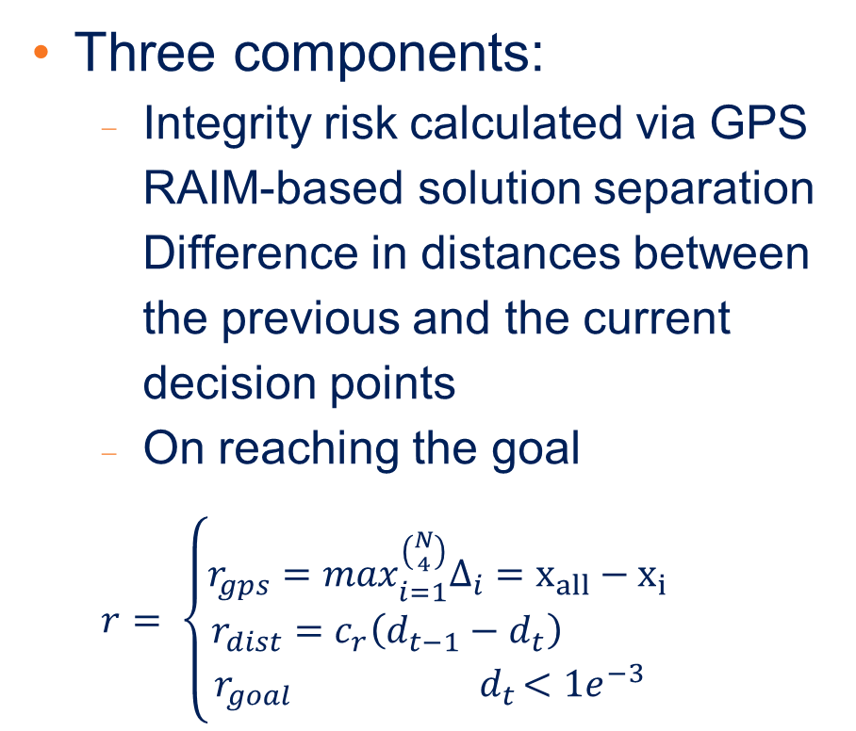
Reward
Three components:
Integrity risk calculated via GPS RAIM-based solution separation Difference in distances between the previous and the current decision points
On reaching the goal
$$r= \left\{\begin{matrix}r_{gps}=\max_{i=1}^{\left({N \atop 4}\right)}Δ_{i}=x_{all}−x_{i} \\ r_{dist}=c_{r}\left(d_{t−1}−d_{t}\right) \\ r_{goal} { d}_{t}<1e^{−3} \end{matrix}\right.$$

Slide 7
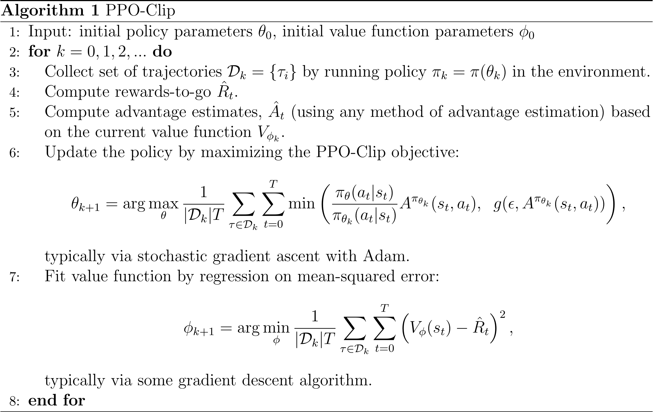
Actor-Critic: Discrete PPO
Separate NN designed for actor and critic
ReLu activation and categorical distribution for the actor
Actor consists of 3 linear hidden layers and critic consists of 4 layers, with 20 nodes in each layer

Slide 8
Outline
Motivation and Prior Work
Algorithm Details
Results
Case #1: Open-sky with 3D robot position as input
Case #2: Urban area with 3D robot position as input
Case #3: Open-sky with observations from GPS and 3D building models/LiDAR as input
Case #4: Urban area with observations from GPS and 3D building models/LiDAR as input

Slide 9
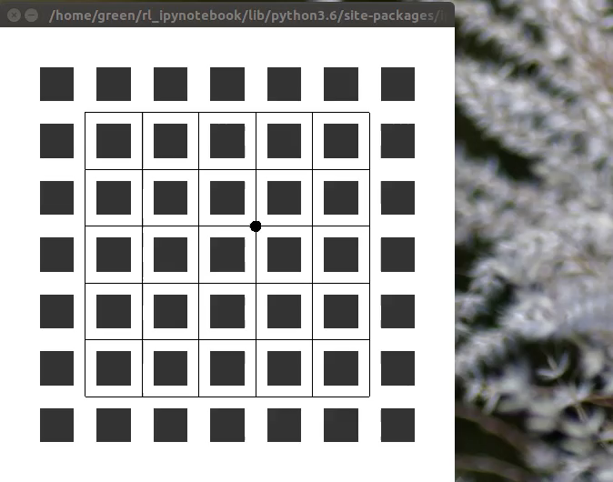
Case #1: Open Sky
Algorithms: Discrete PPO
Input: Current 3D position
Output: Discrete velocity
Heights of buildings are all 20m indicating relatively open-sky conditions
Deep RL-based discrete PPO accurately navigates the robot from arbitrary start position to GOAL

Slide 10
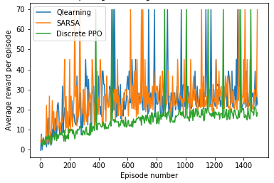
Case #2: Urban Area Results
Input: Current 3D position
Output: Discrete velocity
Episode=100 steps
Heights range between 35-100m
Deep RL-based discrete PPO also converges, but Q-learning and SARSA perform slightly better

Slide 11

Case #3 & #4: Architecture
EKF Measurement Update
GPS antenna
Predicted position
Updated position
pseudoranges
EKF Time Update
RL-based Path Planning
Max height
3D building models/LiDAR
Control action: Velocity
Goal 3D position
GOAL

Slide 12
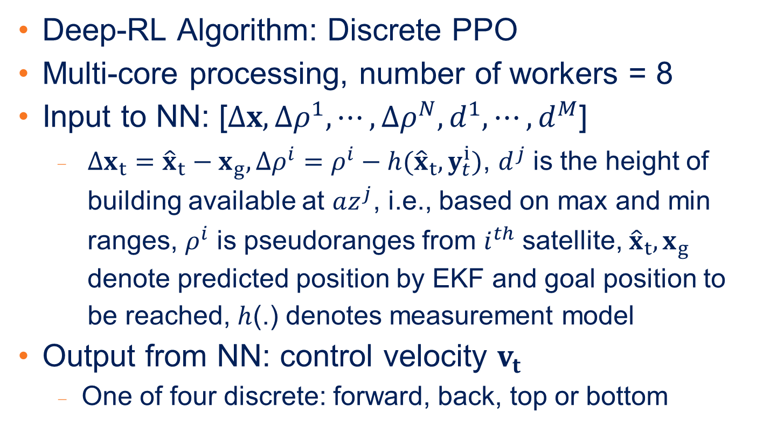
Case #3 & #4: Setup Details
Deep-RL Algorithm: Discrete PPO
Multi-core processing, number of workers = 8
Input to NN: [$Δx, {Δρ}^{1}, ⋯,{Δρ}^{N}, d^{1},⋯,d^{M}$]
$Δx_{t}={\hat{x}}_{t}−x_{g},{Δρ}^{i}=ρ^{i}−h({\hat{x}}_{t}, y_{t}^{i})$, $d^{j}$ is the height of building available at $az^{j}$, i.e., based on max and min ranges, $ρ^{i}$ is pseudoranges from $i^{th}$ satellite, ${\hat{x}}_{t}, x_{g}$ denote predicted position by EKF and goal position to be reached, $h$(.) denotes measurement model
Output from NN: control velocity $v_{t}$
One of four discrete: forward, back, top or bottom

Slide 13
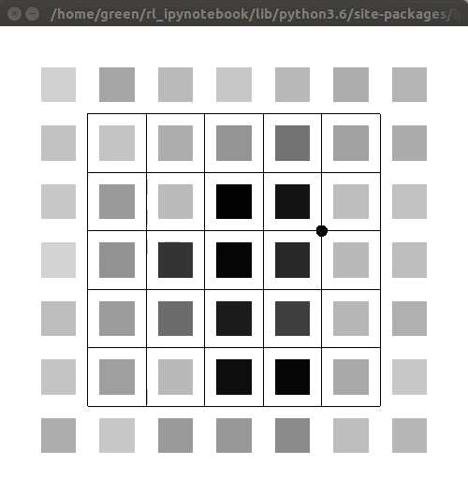
Case #4: Training
Area: 0.25 sq km area with high-rise buildings
Light grey and black indicates height of 20m and 100m, respectively
Training time is ~6 hrs
Average time to goal=69.3s
Deep RL-based discrete PPO converges even when observation vector is used for training

Slide 14
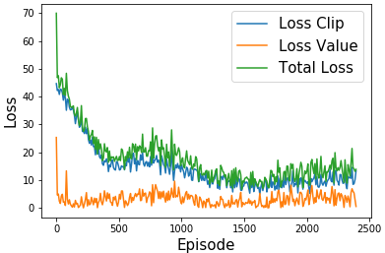
Case #4: Loss Function
Value loss of the critic quickly decreases whereas the clip loss of the actor gradually reduces

Slide 15
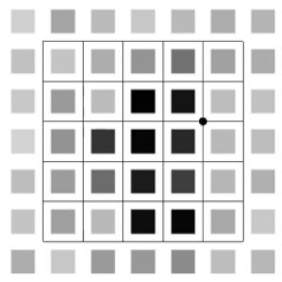
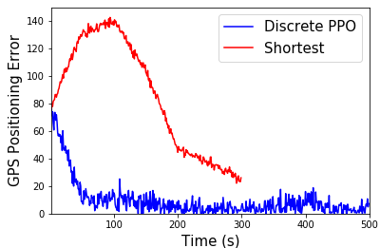
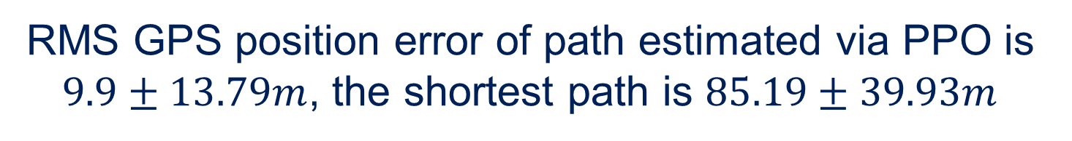
Case #4: GPS Position Error
Goal
Start Point
RMS GPS position error of path estimated via PPO is $9.9±13.79m$, the shortest path is $85.19±39.93m$

Slide 16
Future/Ongoing Work
Incorporate this to my research on SLAM-based integrity estimation
Analyze its performance for a larger urban areas
Utilize the trained policy in one urban section for navigating in another section
Satellites motion and the receiver clock bias errors
Arbitrary goal positions
Extending the work to generic urban area using
Multiple actor and centralized critic to ensure that the robot learns both a local as well as a global policy

Slide 17
Thank you
Sriramya Bhamidipati
Doctoral Student
University of Illinois at Urbana Champaign
Advisor: Prof. Grace Xingxin Gao
Email: sbhamid2@illinos .edu

